Slide 1
Predicting Housing Prices
in Ames, Iowa
Group 1: Amira, Calvin, Joel, Joseph, Joshua, Nelson
DSI-28
13 May 2022

Slide 2
Agenda
Background
Problem Statement
Methodology
Key Findings
Conclusion & Recommendations
Limitations & Next Steps
Notes:
Key Findings
• Insights from EDA (Highly correlated features - most detrimental features)
• Insights from modelling (Features with large coefficients -e.g. Neighborhood + some other general features)
• Unexpected findings (if any)

Slide 3

Background
Ames, Iowa Demographics (2019)
👨‍👨‍👧‍👦 66,258
🏠 $234,100 (median)
💰 $50,528 per capita
Mean property prices
🏠 $236,588 🏬 $127,269
All housing units 2 unit structures
🏘️ $248,938
Detached houses
Notes:
Population
Median house/condo value
Household income

Slide 4
2. Problem Statement
We: Team of data-driven property agents in Ames, Iowa.
You: Home owners in Ames, Iowa.
Why us? Provide insights backed by data instead of mere gut feel.
What’s in it for homeowners:
Optimal selling price
Favourable features of house &/or surroundings
Ways to enhance house’s attractiveness to potential buyers

Slide 5
3. Methodology
Scope of data: Housing prices between 2006 to 2010 in Ames, Iowa
Exploratory Data Analysis (EDA) & Data cleaning
Data preprocessing & modelling

Slide 6
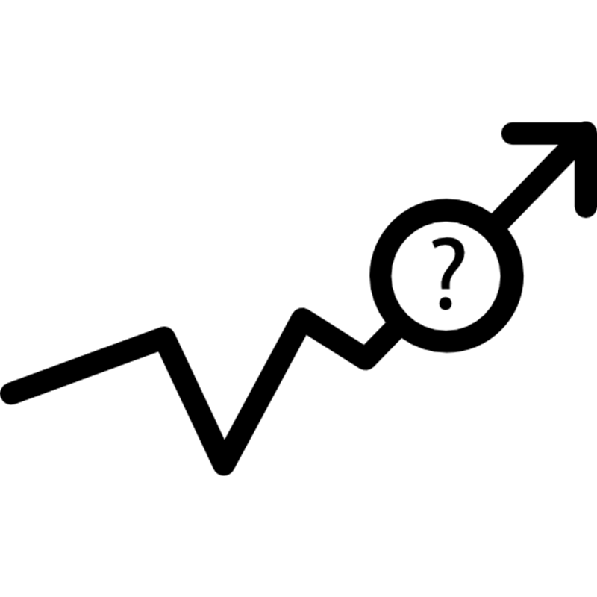
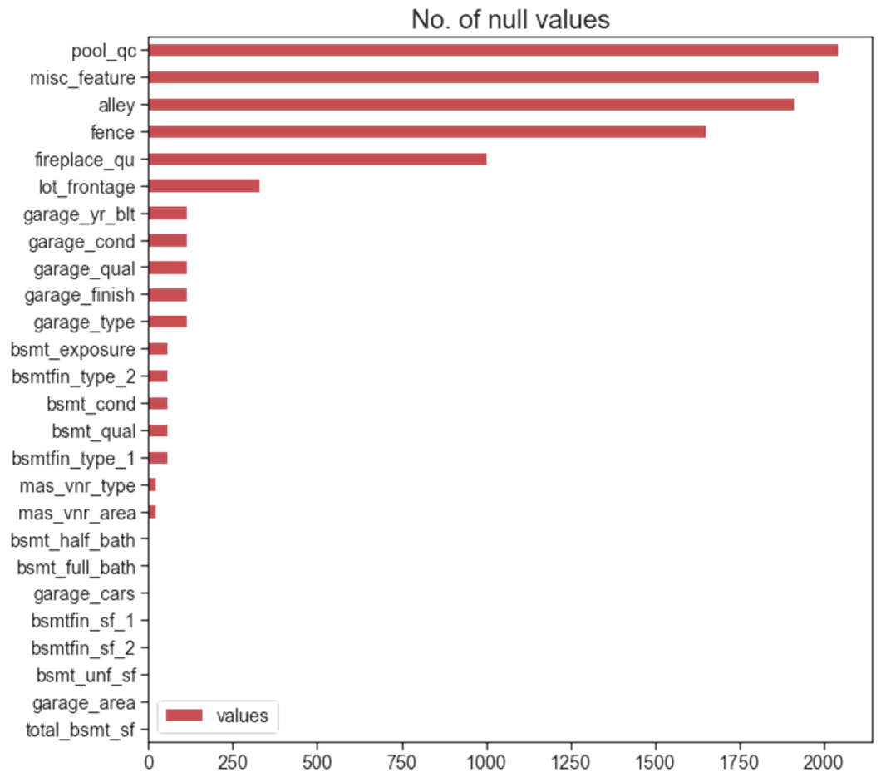
A lot of our data is missing.
Notes:
A lot of data missing; so any analysis will be affected.
For example, in the bar chart shown, we see features with a wide range of null values (from 0.05% to 95%) null values!
This is a problem for us, data scientists, because any modelling will not work with lots of missing values.

Slide 7
Data
Numeric
Categorical
Discrete
Continuous
Nominal
Ordinal
Notes:
In order to address the missing values problem, we first need to understand different types of data structure.
Very simply, numeric/discrete data refers to those countable values while continuous data lies on a spectrum for example height and weight.
Meanwhile, for categorical (non numeric data), we can separate them into two: ordinal refers to those where order is important i.e. ordinal, and those where order is not important i.e. nominal.
This is one of the first steps that our group took when we worked on this dataset. We were most quite particularly on ordinal categorical data e.g. quality and condition of a house from poor to excellent…which we converted to numeric-ordered structure.

Slide 8
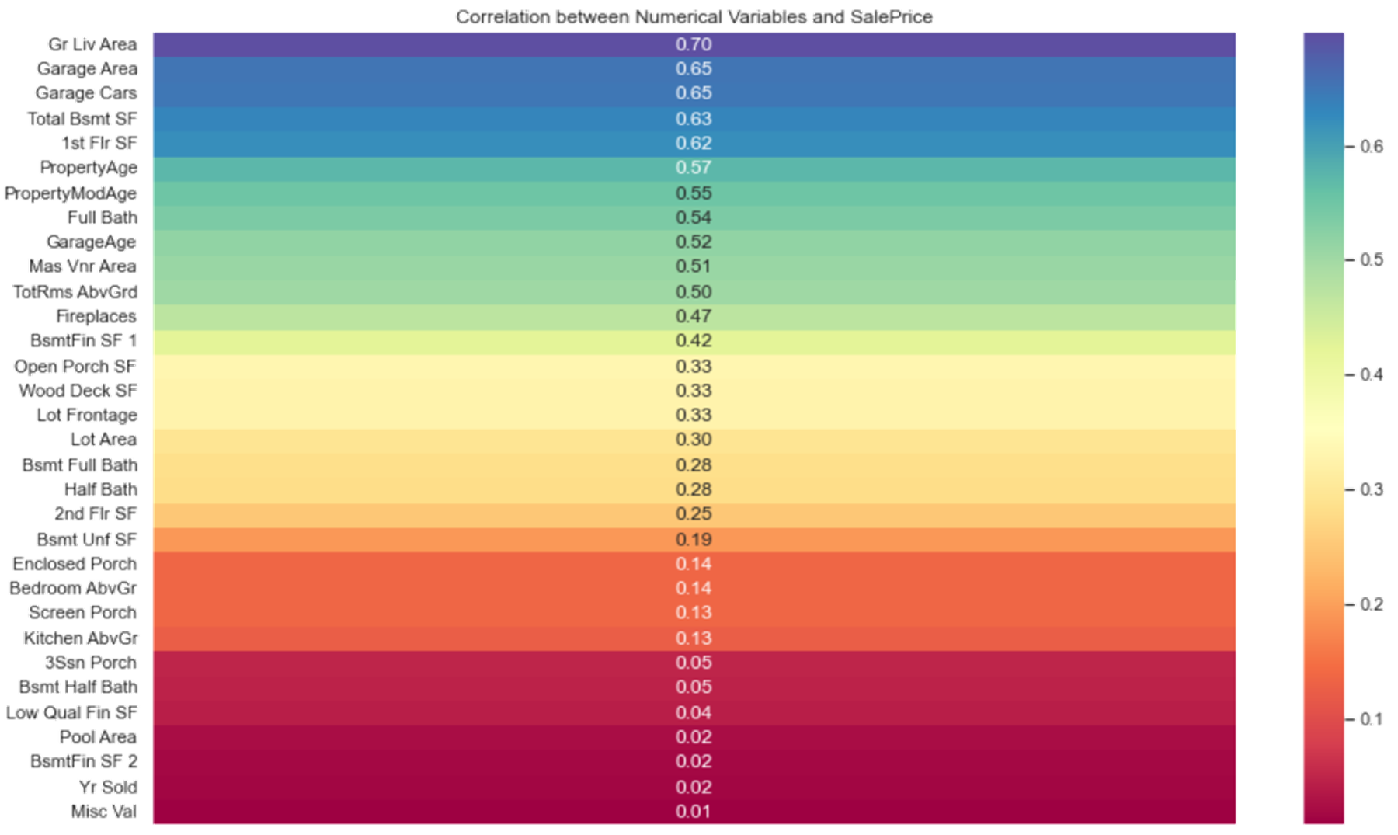
Excluded numeric data with
Weak relationships* to SalePrice
*Weak relationships are defined as those below the threshold of absolute 0.2 to 0.6 correlation coefficient.
Notes:
In order to select features to include in our model, we first looked at the numeric data in our dataset.
What you see here is a very colorful chart, showing the correlation between various numeric variables against the saleprice.
What we did, very simply, was to set a threshold of correlation coefficient and subsequently ‘keep’ or ‘throw’ them. I.e. we kept the top half above the horizontal red line, and set aside the bottom half.

Slide 9
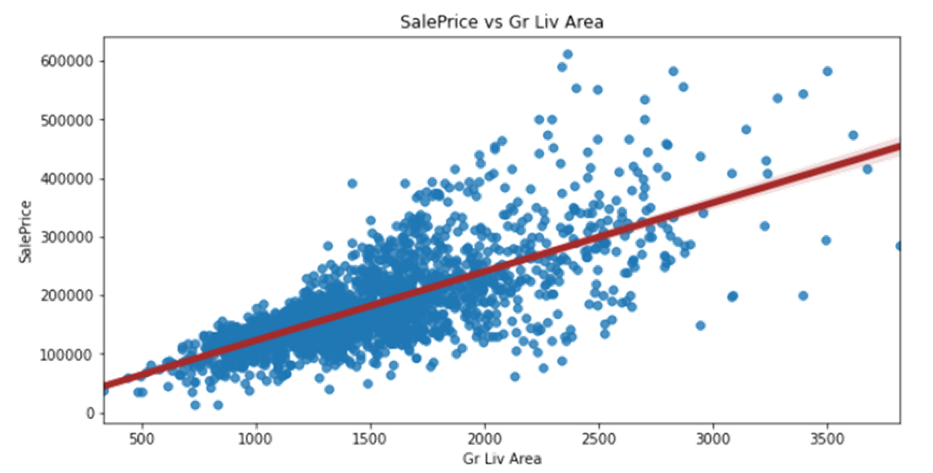
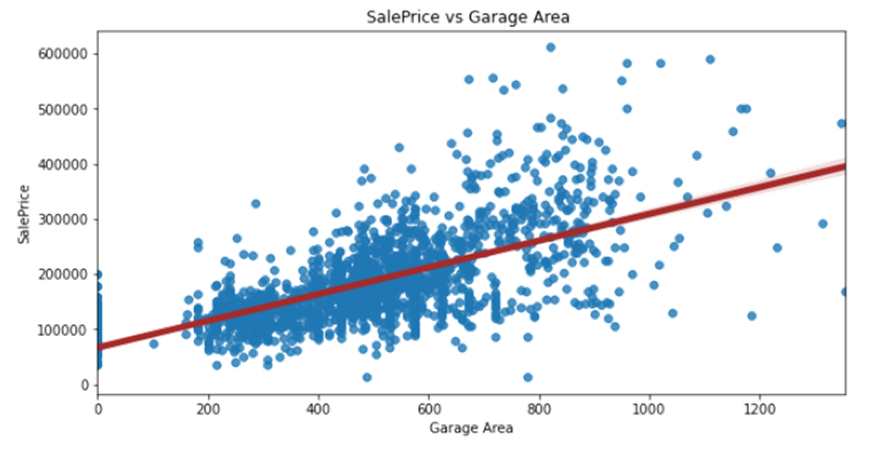
As ground liv area
SalePrice
As garage area
SalePrice
r = 0.7
r = 0.65
Notes:
While the previous chart gives us a very quick overview of the correlation coefficient for variables against sale price, we also looked into each numeric variable individually to understand how they are correlated to sale price.
In the chart above on ground living aera and garage area, we can see that the red slopes have quite a significant gradient. You can also see that the correlation coefficient r - is slightly higher for ground living area than garage area (0.05).

Slide 10
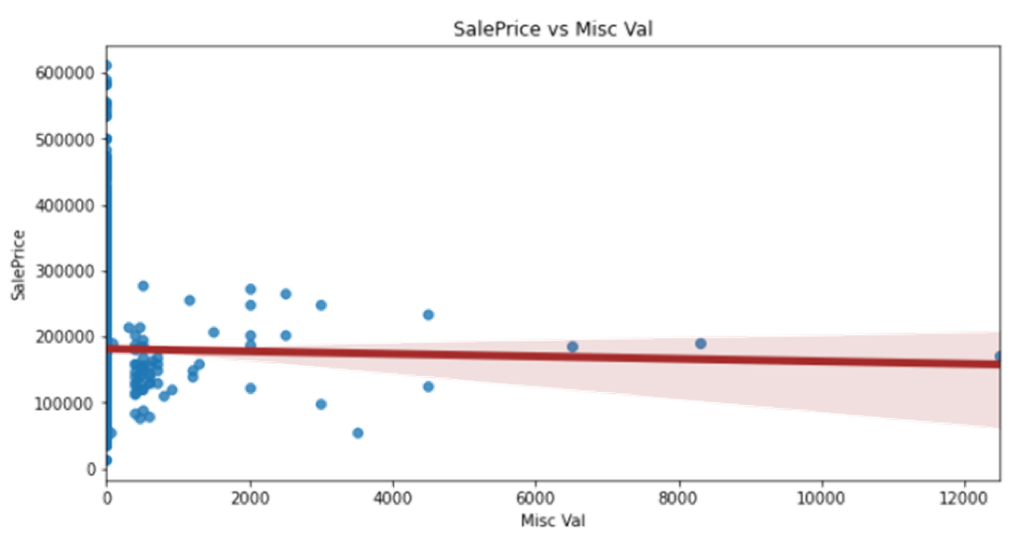
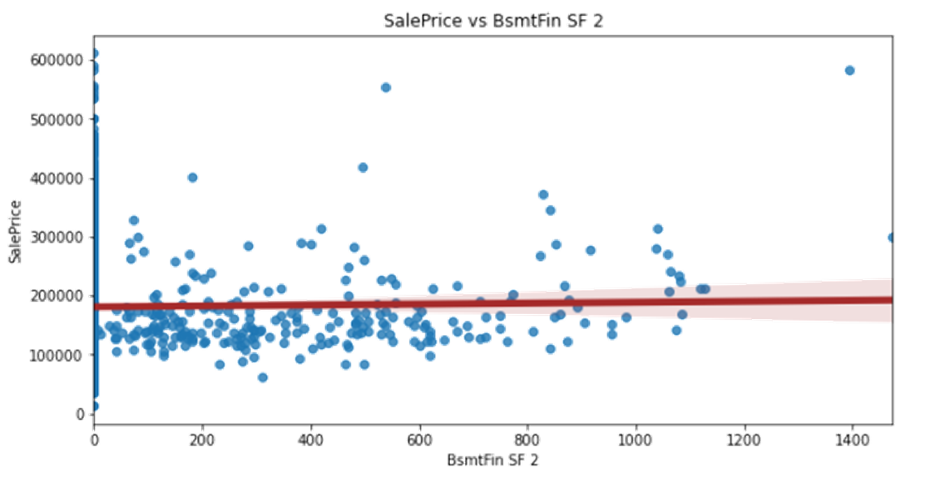
Data has insignificant
relationship with SalePrice
r = 0.01
r = 0.02
Notes:
In comparison,for these features where the red line is kind of horizontal (no much difference gradient). This shows that the features are not related to each other at all, and will not be significant for our modelling step.

Slide 11
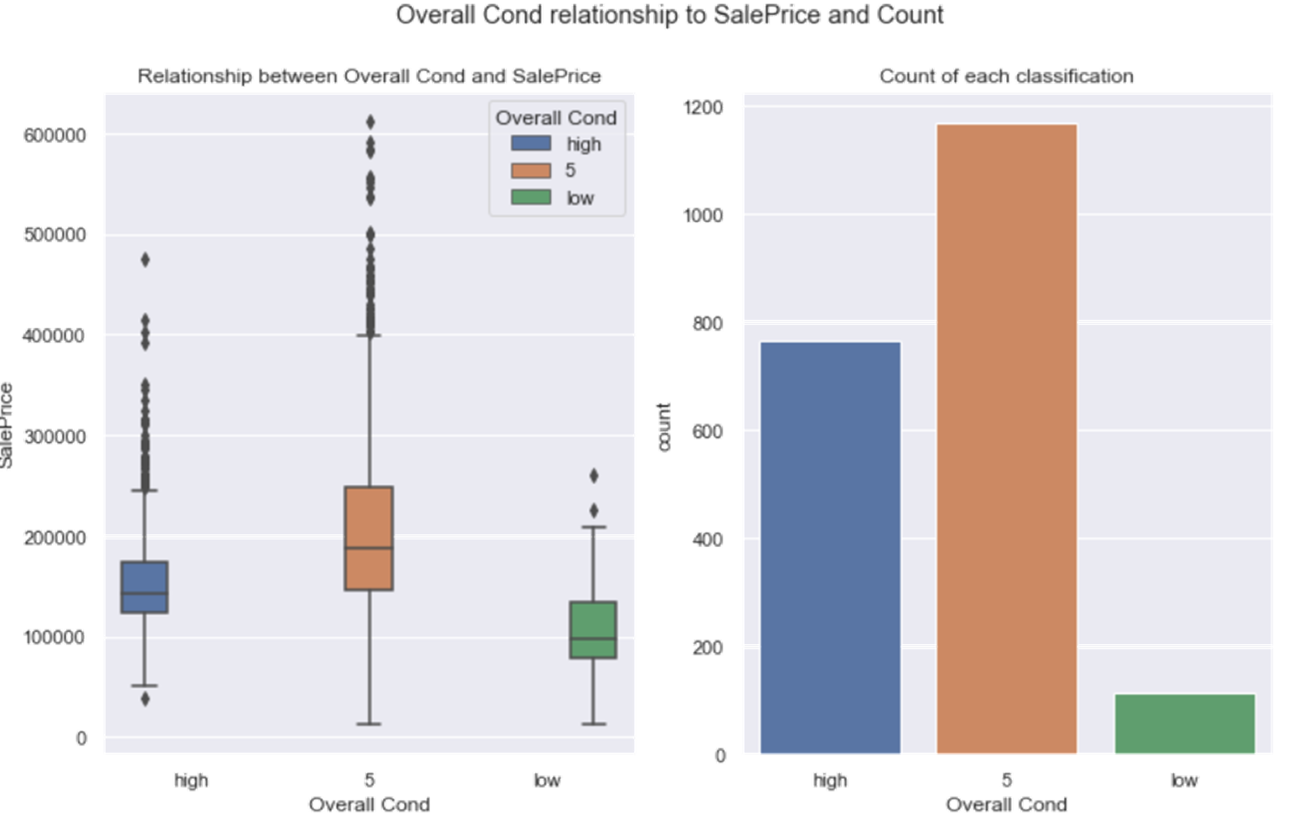
4. Unexpected Findings - Overall Condition of Property (Overall Cond)
Overall Condition of Property (Overall Qual)
Excellent overall condition
does not mean price
Notes:
We found an interesting feature while we were exploring the data: overall condition.
Naturally, as home owners, as your house is rated to be of better position, you would expect it to be priced higher.
Based on the plot on the left, the results are uninuitive and contradictory.
Based on the left chart: properties with lowly rated conditions fetched low scores, which makes sense. But if look at the left chart.

Slide 12
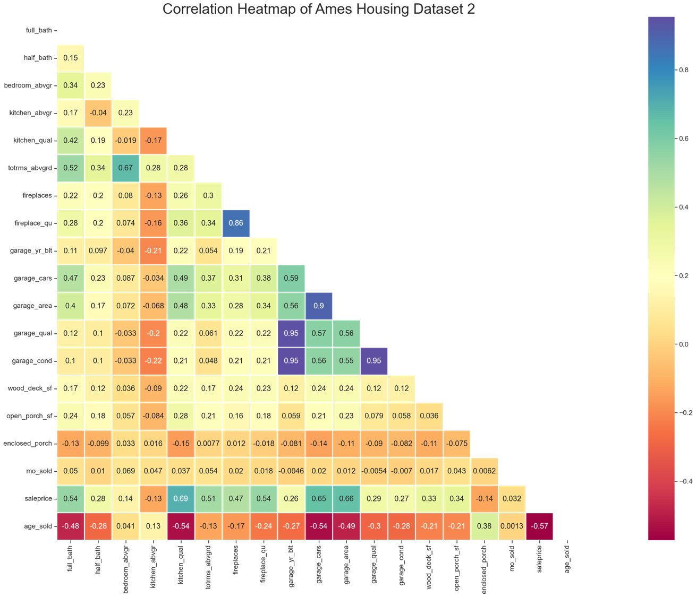
Some data points are highly
related to each other
Notes:
Next, we also looked out for data points that very strong related to each other.
Let me orientate you to this chart. The vertical scale on the right shows the spectrum based on the value of the correlation coefficient which essentially tells us how closely related two variables are.
What we are looking for are pairs of variables with the dark colors of purple or blue, which have already been circled.
When we examine each pair of variables, we can understand why the variables had high correlation values. For instance, garage_area and no_of_garage cars - more cars can fit in a large garage area, as compared to a small area - so for our case, we decided to select garage_area since the value in square feet is more granular.

Slide 13
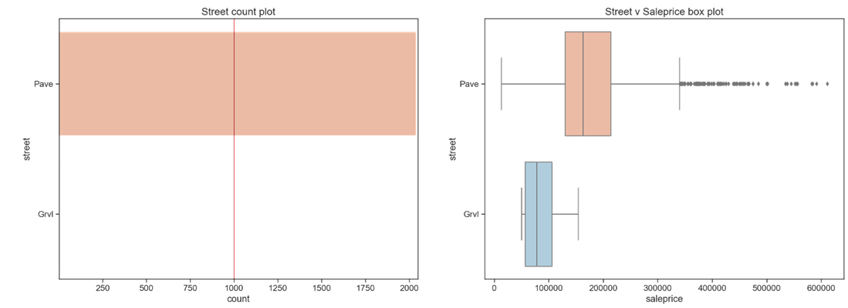
Excluded categorical data that
had a single, dominant category
Notes:
Finally for categorical data, we also had to look thru each feature and decide which ones to keep for modelling and which ones to set asides.
For each feature, we looked out for those which had a single dominant category, which are basically those at exceed a threshold that we have pre-determined.
In the chart on the left, which counts the number of observations for each category, we noted that a house with paved road access is common across the houses in our dataset. The number of houses with gravel road is very small. Similarly when we look at the box plots on the right, we can tell that no matter which sale price, most houses are have paved road. Therefore, we decided to not use this variables for our modelling.
There were many other features that we selected (or not) based on the methods that i explained. For those features that we found to be not so highly correlated to saleprice, we did another round of assessment to determine if we can use them for our modelling - Joseph will run through with you how we went about with feature engineering, next.

Slide 14

Feature Engineering
Variables with weak correlation with Sale Price:
OpenPorchSF
EnclosedPorch
3SsnPorch
ScreenPorch
PoolArea
Bsmt_Cond
BsmtFinType1
BsmtFinSF2
BsmtFinType2
WoodDeckSF

Slide 15

Feature Engineering
OpenPorchSF
EnclosedPorch
3SsnPorch
ScreenPorch
PoolArea
TotallivingPremiseSF
OpenPorchSF + EnclosedPorch + 3SsnPorch + ScreenPorch + PoolArea + GrLivArea
Notes:
No expletives in presentation please

Slide 16
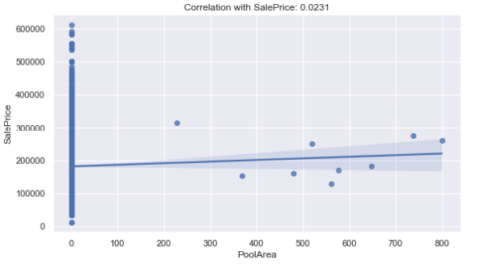
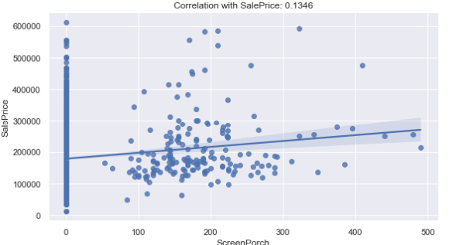
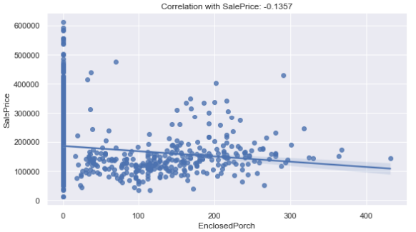
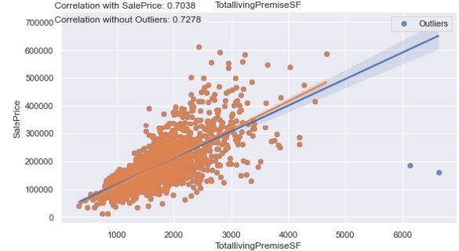

Feature Engineering
Notes:
No expletives in presentation please

Slide 17

Feature Engineering
TotalBsmtSF
Bsmt_Qual
Bsmt_Cond
BsmtExposure
Bsmtstandard
TotalBsmtSF+ (Bsmt_Qual ^2 + Bsmt_Cond+ BsmtExposure^2)
Notes:
No expletives in presentation please

Slide 18
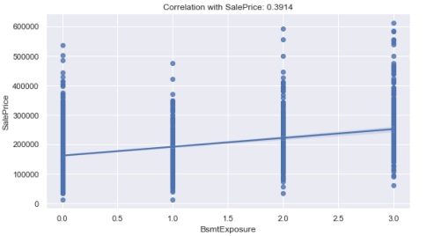
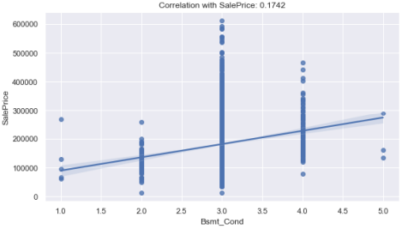
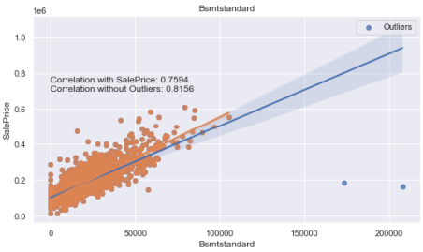

Feature Engineering
Notes:
No expletives in presentation please

Slide 19

Feature Engineering
GarageArea
GarageQual
Garagestandard
GarageArea x GarageQual
Notes:
No expletives in presentation please

Slide 20
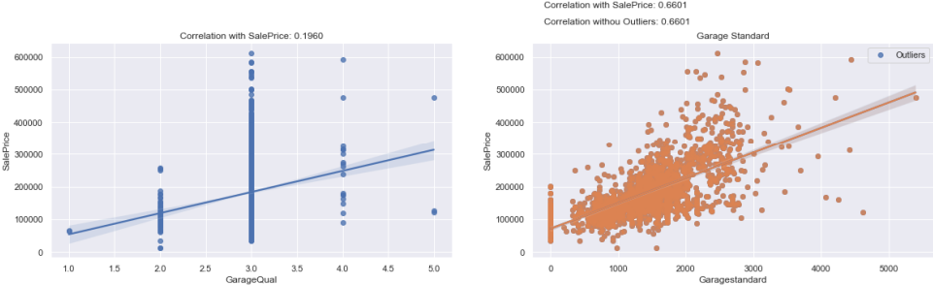

Feature Engineering

Slide 21
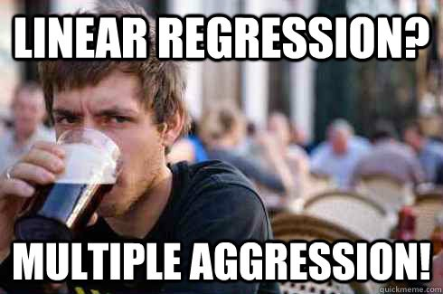
List Of Regressions Used
Linear Regression
Lasso Regression
Ridge Regression
Notes:
Using

Slide 22
Agent 1’s Model - Ridge Regression
Ridge Regression best, based on Root Mean Square Error (RMSE)
Imputed continuous, numerical variables using average, and categorical variables using the most observed categories.
Notes:
Ridge regression is best

Slide 23
Agent 2’s Model - Lasso Regression
Rank features based on the strength of their influence
→ the stronger, the better
Imputed continuous, numerical variables using iterative imputer
Notes:
Now that we see Agent 1’s model is inaccurate, Agent 2 came to the rescue!
Agent 2 uses Lasso regression as his modelling. Lasso regression is able to rank features based on the strength of their influence. It can even get features with very weak strength (close to 0). As agent 1 mentioned, lasso regression is the alternative to linear regression in a sense that lasso regression line can be adjusted to fit in to more variety of data and it’s much more flexible
On top of that agent 2 also imputed the continuous and numerical null variables using iterative imputer. Iterative imputer will use the best estimator to predict the null values based on variables that are likely to influence the columns with null variables. Therefore, this will simulate a more real situation and distribution of data rather than just imputing the basic mean, mode or median.

Slide 24
H2H Model Performance
Model | Metric (RMSE) | Stability
Model 1 - Agent 1’s Ridge | 26, 364 | Less stability
Model 2 - Agent 2’s Lasso | 25, 530 | More stability
Final number of features: Model 1 - 44 features ( 16 categorical and 28 numerical features)
Final number of features: Model 2 - 57 features ( 32 categorical and 25 numerical features)
Notes:
So if we look at the H2H model performance, we can see that agent 2’s Model RMSE is better than agent 1’s model RMSE. This is due to the imputing method that agent 2 utilised and also lasso regression that is much more aggressive in getting all the features including those that has very very weak strength close to 0 compared to ridge. In addition, agent 2 lasso model is less erratic or more stable. As agent 2 remove variables with very weak strength, the remaining variables with relatively higher strength will be sizeable and become non-negligible. Thus, this will reduce the variance of the model itself.
We can also see the final number of features. Model 2 has more features than model 1. As model 2 has more features, it doesnt remove information to predict the Sale Price.
Now that the team has decided on agent 2’s model performance, i’ll pass the time to Calvin on the tips on enhancing your house value based on the model.

Slide 25
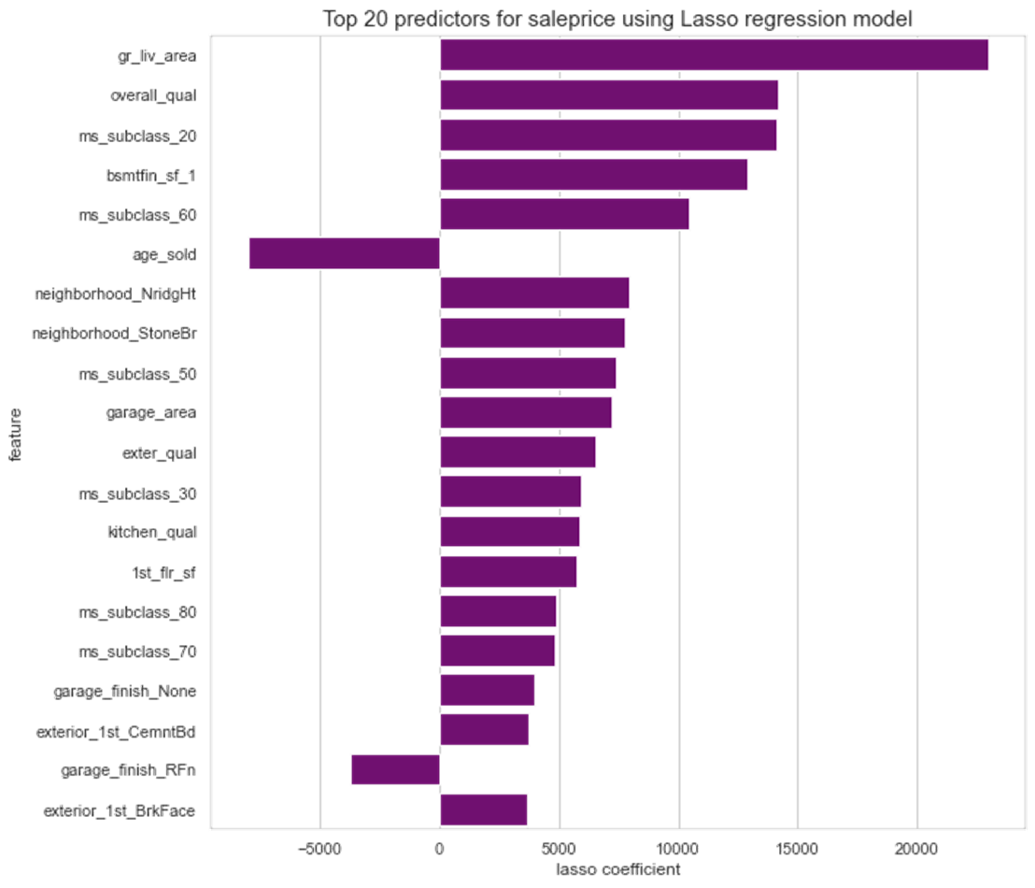
Top 3 Tips to enhancing your house’s value
Want better offers for your house?
Maintain good / excellent quality of house thru regular maintenance and upkeep of interior / exterior features
Have good / excellent quality kitchen to attract better prices
Consider remodelling esp if house is old, to reinstate it to its former glory, i.e. Uplift overall quality of house

Slide 26
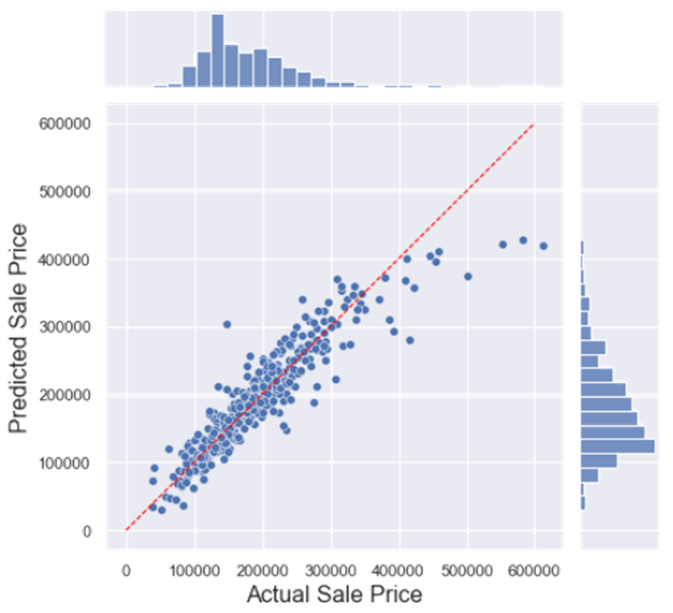
Technical Limitations
and Next Steps
Our pricing model will underprice properties with high expected Sale Price
Looking at the increasing size of error as Sale Price gets large, can experiment with non-linear forms
Notes:
This slide can be on technical limitations

Slide 27
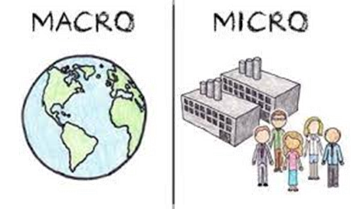
General Limitations
Notes:
This slide can be on technical limitations

Slide 28



MICRO | MACRO
Lacking further data points | Bank interest mortgages
Ambiguity in given dataset (overall qual? Bsmt qual? How is it determined?) | Unemployment rates
Dataset is specific to Ames only | Crime rates

Slide 29
THANK YOU

